Slide 1







DAILY ENERGY CONSUMPTION
PREDICTION WITH MLFLOW
Done by: Ayah Kouider
Student ID :2104620

Slide 2






PROBLEM STATEMENT
Challenges:
High variability in energy consumption
Lack of real time insights
Data from Multiple Sources
Uses:
Demand forcasting
Energy efficiency
Anomaly Detection
Smart building management.

Slide 3
DATASET: INDIVIDUAL HOUSEHOLD ELECTRIC POWER CONSUMPTION
Features:
Global_active_power
Global_reactive_power
Voltage
Global_intensity
Sub_metering_1/2/3
Date and Time
Target:
Global_active_power

Slide 4
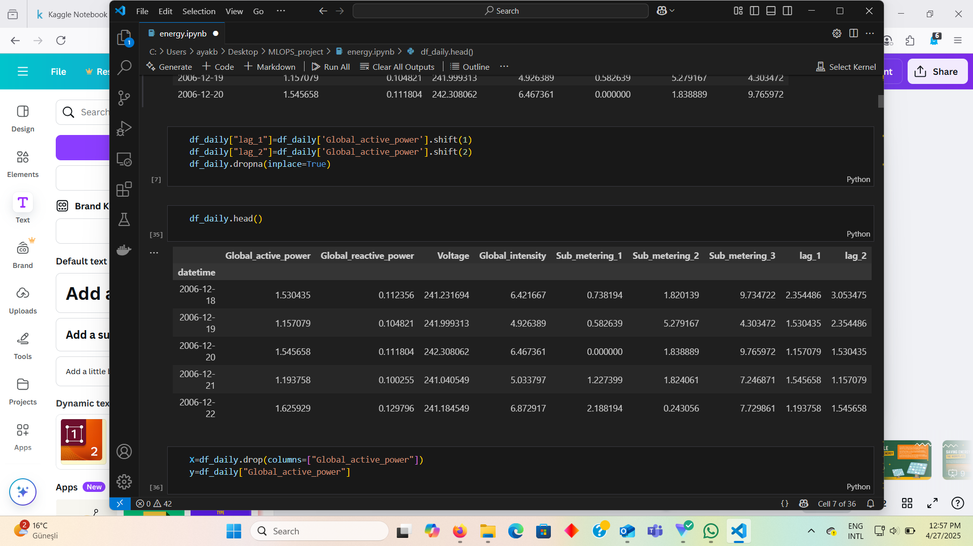
DATA PREPROCESSING
Handles missing vallues.
Converted 'Date' and 'Time' into datetime type.
Resampled the data from hourly to daily
Added lag features to capture trends.

Slide 5


MODEL TRAINING AND MONITORING
Model Training
WITH MLFLOW
Hyperparameter Tuning
Model registry
Model Deployment
Monitoring

Slide 6
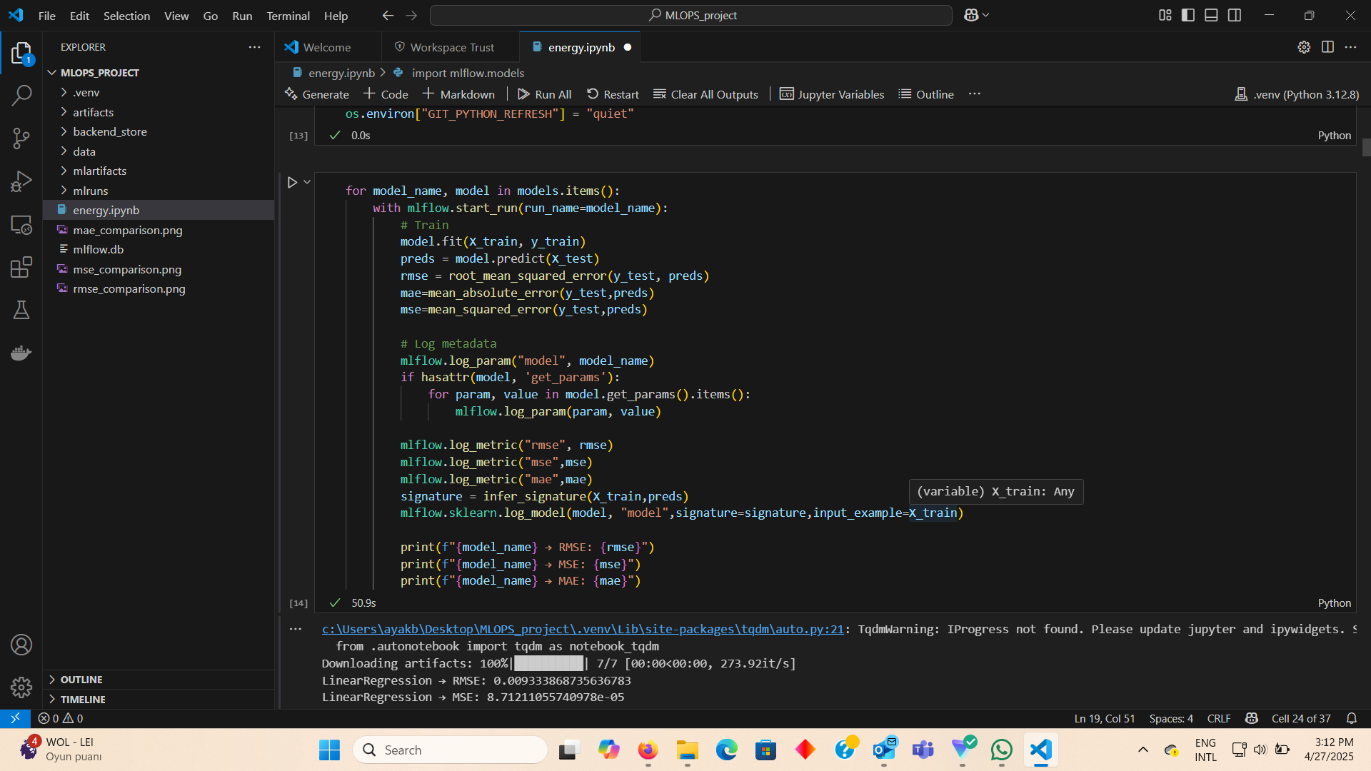
MODEL TRAINING
Models Trained:
Linear Regression
XGBoost
Random Forest
SVM/SVR

Slide 7
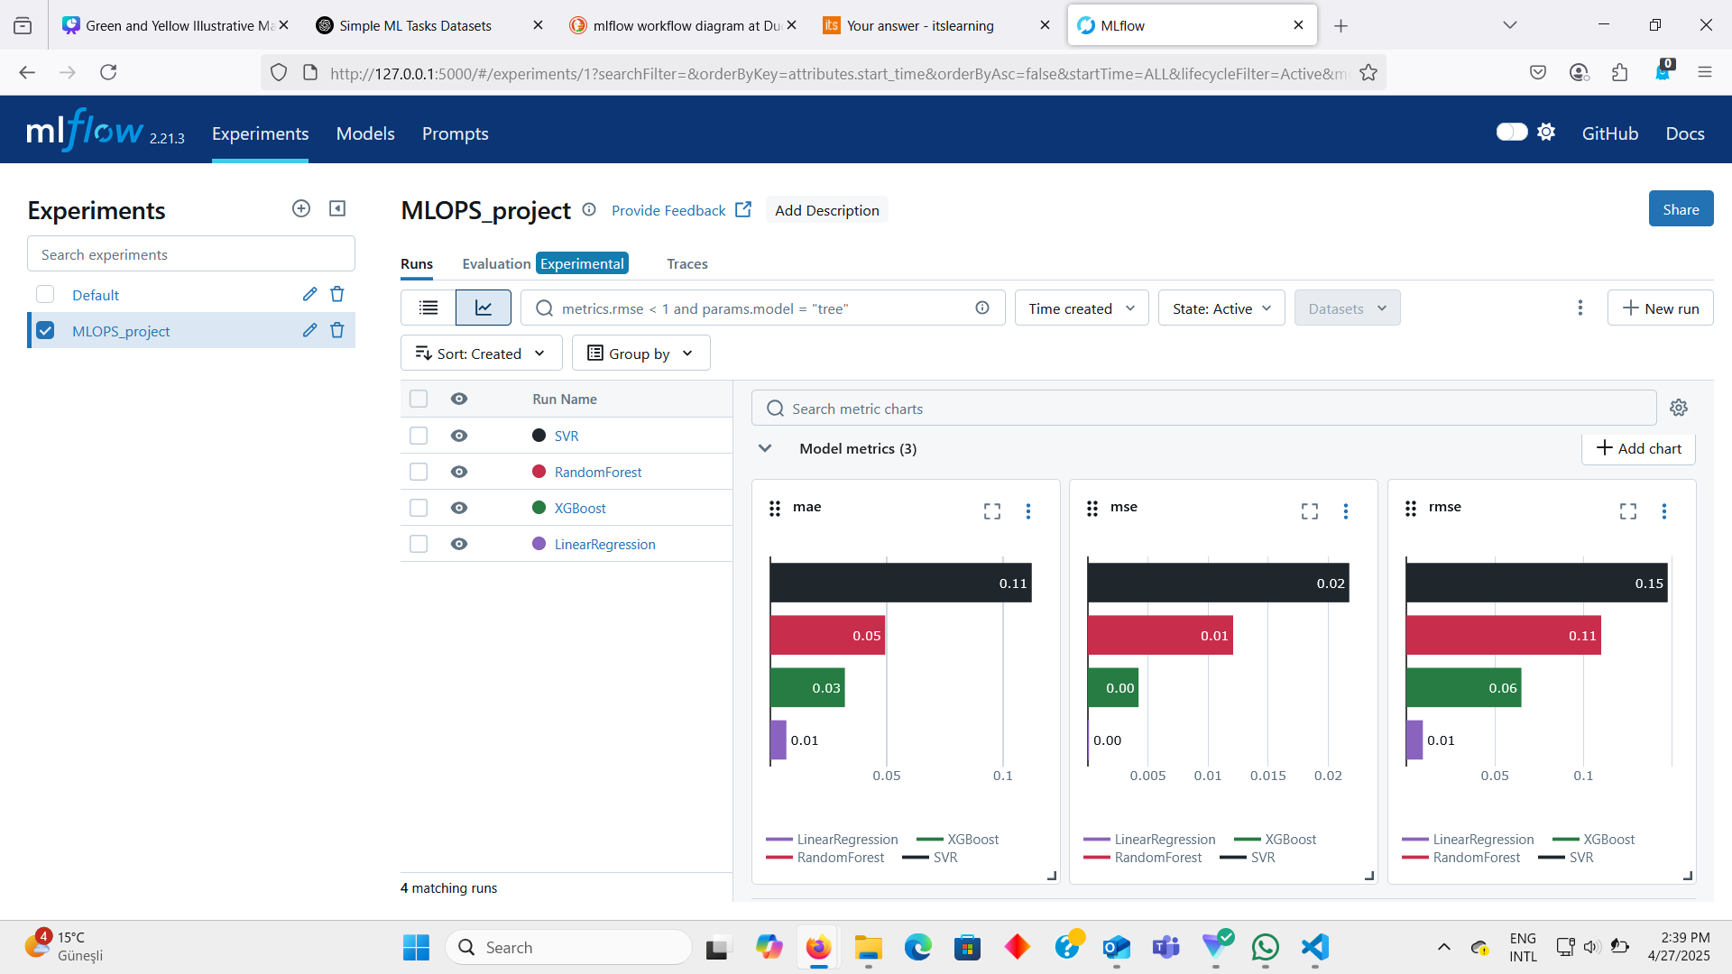

Slide 8
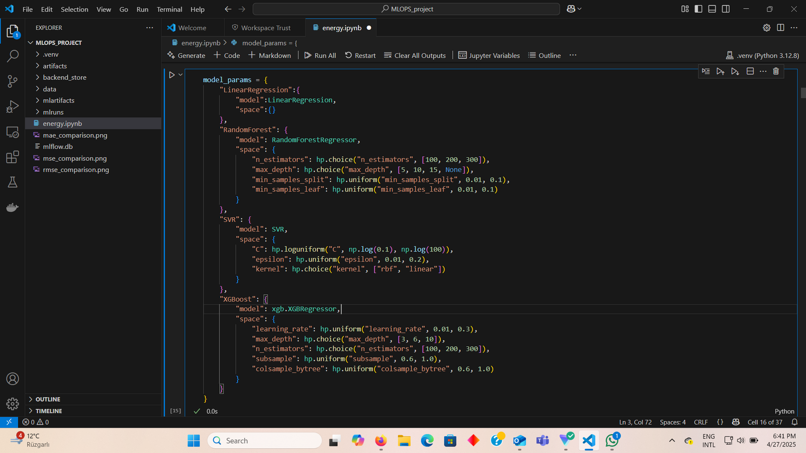
HYPERPARAMETER TUNING
mlflow integration:
Automated logging of each hyperparameter trial.
Tracked best parameters and their metrics.
library used:
Hyperopt

Slide 9
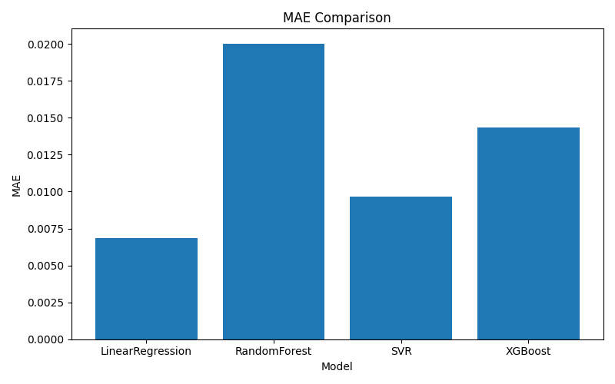
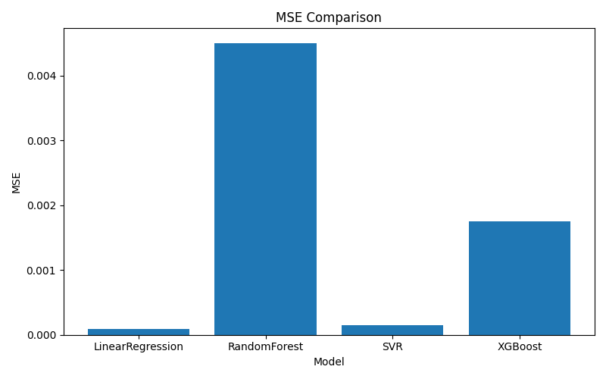
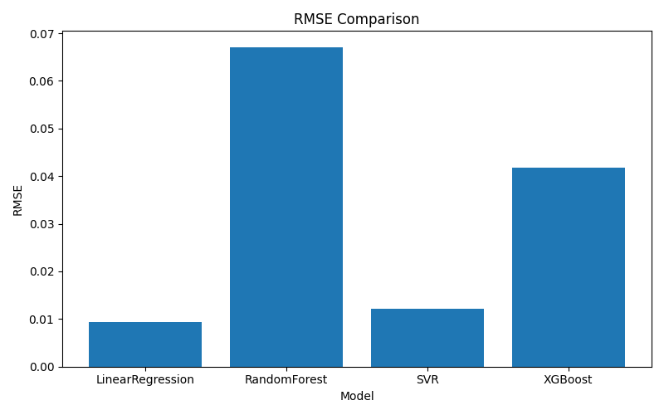

Slide 10
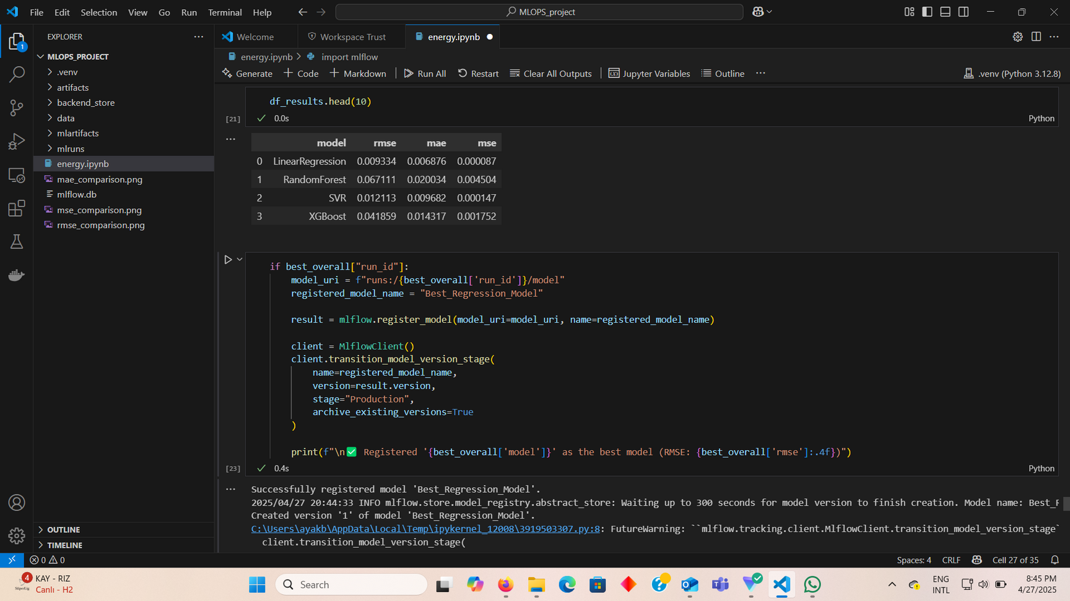
MODEL REGISTRY AND DEPLOYMENT
Registered best model in MLFlow model registry.
Moved model to production stage.
Deployed the model using serve functionality.
mlflow models serve -m runs:/<run_id>/model --port 5000

Slide 11
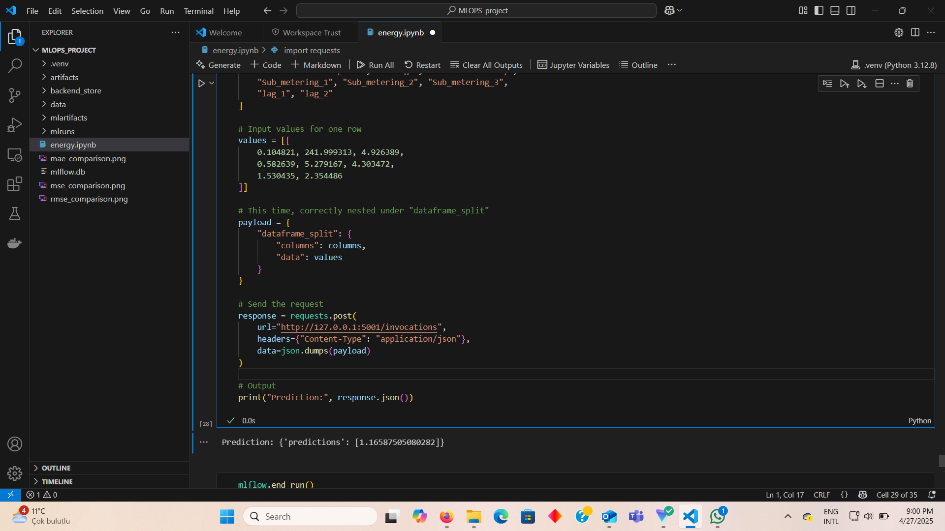
MODEL MONITORING
Sent test data to model using request.
Created a monitoring run and collected prediction.
Compared with actual data and logged metrics.

Slide 12
IMPROVEMENTS
Set up automatic retraining pipelines.
Add real-time monitoring.
Implement automatic alerts for performance degradation.

Slide 13


THANK YOU FOR LISTENING
Do you have any questions?

